Slide 1
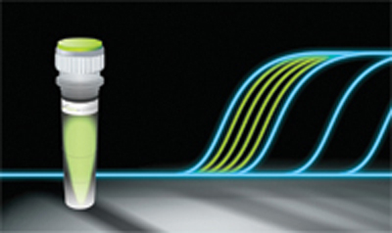
PCR Quantitation (qPCR)
Present by: Dr Niloofar Neisi
PhD of Virology

Slide 2
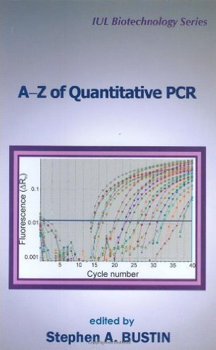



Slide 3
How does real-time PCR work?
To best understand what real-time PCR is, let’s review how regular PCR works...

Slide 4
The Polymerase Chain Reaction
How does PCR work??

Slide 5
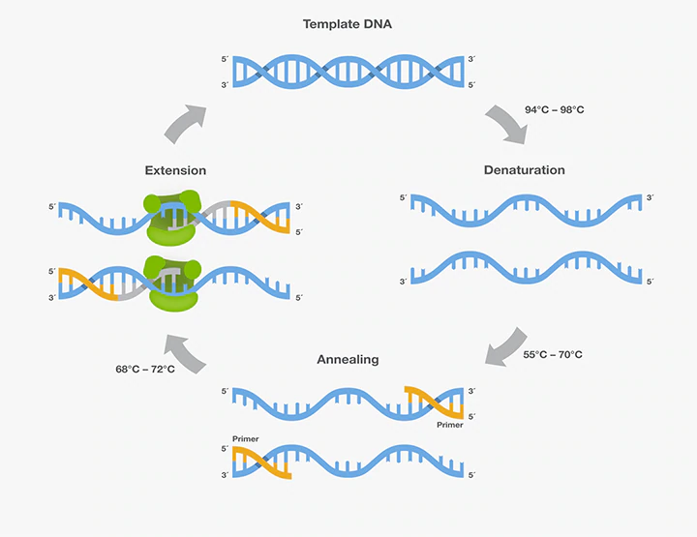

Slide 6
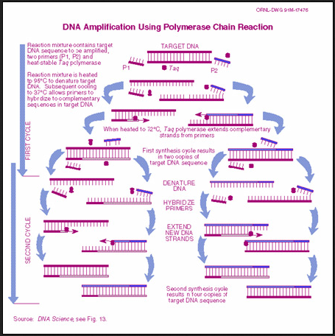

Slide 7
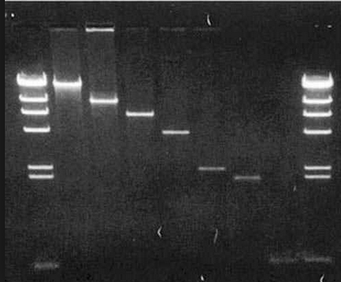
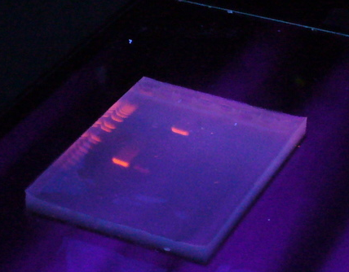
Gel base detection

Slide 8
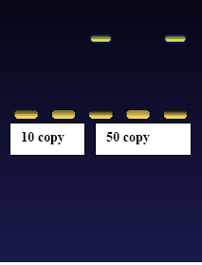
What’s Wrong With Agarose Gels?
Low sensitivity
Low resolution
Non-automated
Size-based discrimination only
Results are not expressed as numbers
→ based on personal evaluation
Ethidium bromide staining is not very quantitative
End point analysis

Slide 9
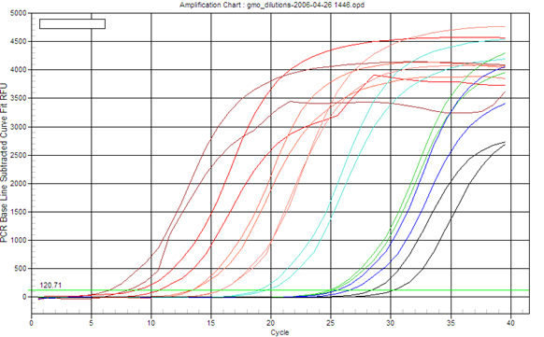
What is Real-Time PCR?
The Polymerase Chain Reaction (PCR) is a process for the amplification of specific fragments of DNA.
Real-Time PCR a specialized technique that allows a PCR reaction to be visualized “in real time” as the reaction progresses.
As we will see, Real-Time PCR allows us to measure minute amounts of DNA sequences in a sample!
real time : the actual time during which a process or event occurs

Slide 10
What is Real-Time PCR?
Differences with normal PCR?
20ul PCR reactions
SYBR Green or probes
94°C 4 min
94°C 15 sec
61°C 30 sec
72°C 30 sec
40x

Slide 11
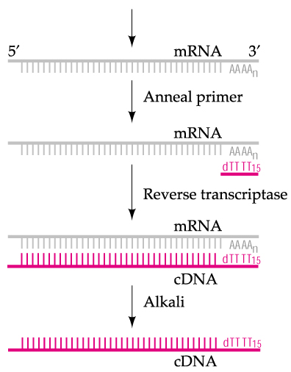
What is Real-Time PCR?
Taq polymerase can only synthesize DNA, so how do we study gene expression (RNA) using qPCR?
Reverse transcription
RNA -> DNA (cDNA)

Slide 12
What is Real-Time PCR used for?
Real-Time PCR has become a cornerstone of molecular biology:
Gene expression analysis
  Medical research (SNP, tumor and normal, signaling pathway)
  Drug research
Disease diagnosis
  Viral quantification
Food testing
  Percent GMO food
Transgenic research
  Gene copy number

Slide 13
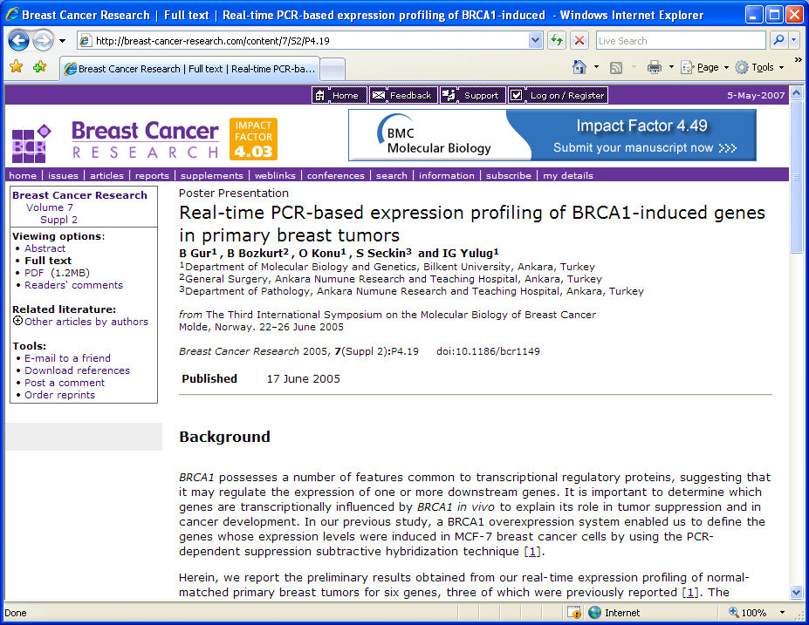
Real-Time PCR in Gene Expression Analysis
Example: BRCA1 Expression Profiling
BRCA1 is a gene involved in tumor suppression.
BRCA1 controls the expression of other genes.
In order to monitor level of expression of BRCA1, real-time PCR is used.
DNA
BRCA1
mRNA
Protein

Slide 14
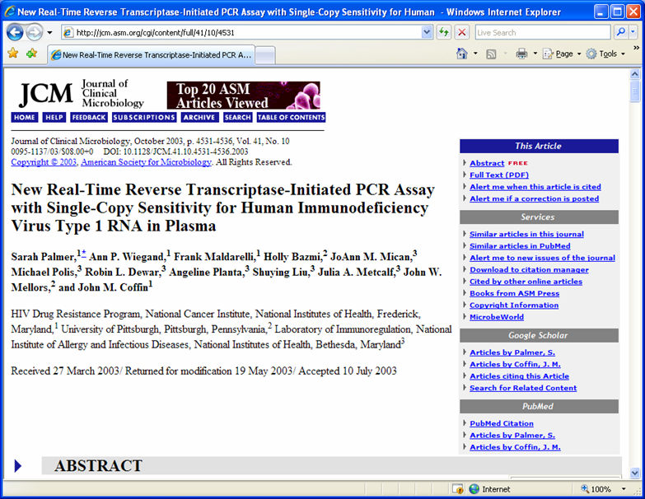
Real-Time PCR in Disease Management
Example: HIV Treatment
Drug treatment for HIV infection often depends on monitoring the “viral load”.
Real-Time PCR allows for direct measurement of the amount of the virus RNA in the patient.
Virus
RNA

Slide 15
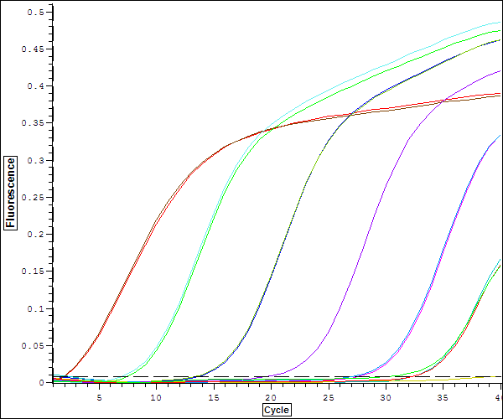
How does Real-Time PCR work?

Slide 16
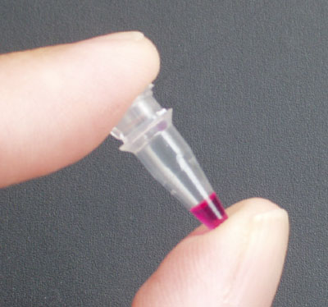
Imagining Real-Time PCR
To understand real-time PCR, let’s imagine ourselves in a PCR reaction tube at cycle number 25…

Slide 17


Imagining Real-Time PCR
What’s in our tube, at cycle number 25?
A soup of nucleotides, primers, template, amplicons, enzyme, etc.
~1,000,000 copies of the amplicon right now.

Slide 18

Imagining Real-Time PCR
How did we get here?
What was it like last cycle, 24?
  Almost exactly the same, except there were only 500,000 copies of the amplicon.
And the cycle before that, 23?
  Almost the same, but only 250,000 copies of the amplicon.
And what about cycle 22?
  Not a whole lot different. 125,000 copies of the amplicon.

Slide 19

Imagining Real-Time PCR
How did we get here?
If we were to graph the amount of DNA in our tube, from the start until right now, at cycle 25, the graph would look like this:

Slide 20

Imagining Real-Time PCR
So where are we going?
What’s it going to be like after the next cycle, in cycle 26?
  Probably there will be 2,000,000 amplicons.
And cycle 27?
  Maybe 4,000,000 amplicons.
And at cycle 200?
  In theory, there would be 1,000,000,000,000,000,000,000,000,000,000,000,000,000,000,000,000,000,000,000 amplicons…
?

Slide 21

Imagining Real-Time PCR
So where are we going?
If we plot the amount of DNA in our tube going forward from cycle 25, we see that it actually looks like this:
Realistically, at the chain reaction progresses, it gets exponentially harder to find primers, and nucleotides. And the polymerase is wearing out.
So exponential growth does not go on forever!

Slide 22

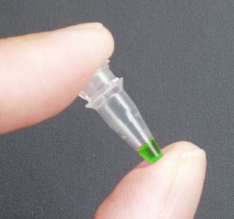
Imagining Real-Time PCR
Measuring
Quantities
How can all this be used to measure DNA quantities??
What if YOU started with FOUR times as much DNA template as I did?
I have 1,000,000 copies at cycle 25.
You have 4,000,000 copies!
So… You had 2,000,000 copies at cycle 24.
And… You had 1,000,000 copies at cycle 23.
Notes:
شما تصور کنید میزان DNA من در سیکل 25 تعداد 1000000 کپی است. اگر شما 4000000 کپی داشته باشید سیکل شما چند خواهد بود?

Slide 23
Imagining Real-Time PCR
Measuring
Quantities
So… if YOU started with FOUR times as much DNA template as I did…
Then you’d reach 1,000,000 copies exactly TWO cycles earlier than I would!

Slide 24

What if YOU started with EIGHT times LESS DNA template than I did?
You’d only have 125,000 copies right now at cycle 25…
…and you’ll have 250,000 at 26, 500,000 at 27, and by cycle 28 you’ll have caught up with 1,000,000 copies!
So… you’d reach 1,000,000 copies exactly THREE cycles later than I would!
Imagining Real-Time PCR
Measuring
Quantities

Slide 25
The “ct value”
Imagining Real-Time PCR
Measuring
Quantities
The value that represents the cycle number where the amplification curve crosses an arbitrary threshold.
Ct values are directly related to the starting quantity of DNA, by way of the formula:
Quantity = 2^^{Ct}
Ct Values:
23
25
28
Threshold

Slide 26
PCR
The amount of DNA doubles after each cycle
Assuming 100% efficient PCR reactions
After n cycles there will be 2^{n} times as much DNA
Notes:
First of all we need to think about the nature of the PCR reaction in order to understand real time quantitation. The amount of DNA theoretically doubles with every cycle of PCR and this is what this shows, after each cycle the amount of DNA is twice what it was before.
After one cycle of PCR, the amount of DNA is twice what it was before, so after two cycles one has 2x2 times as much, after 3 cycles - 2x2x2 times as much or 2³ times as much, after 4 cycles 2x2x2x2 times as much or 2⁴ times as much. Thus after n cycles there will be 2^{n} times as much DNA.

Slide 27
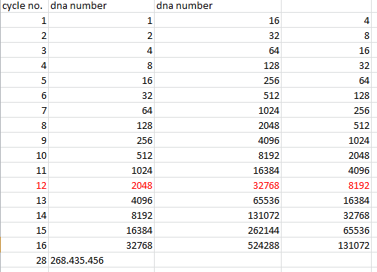

Slide 28
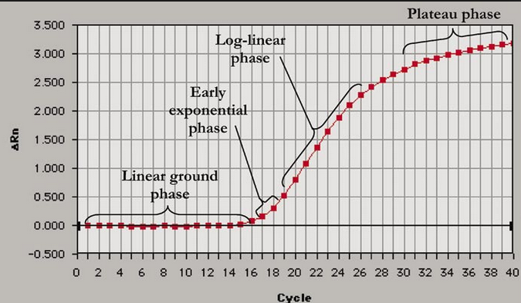
Plot of real time pcr

Slide 29
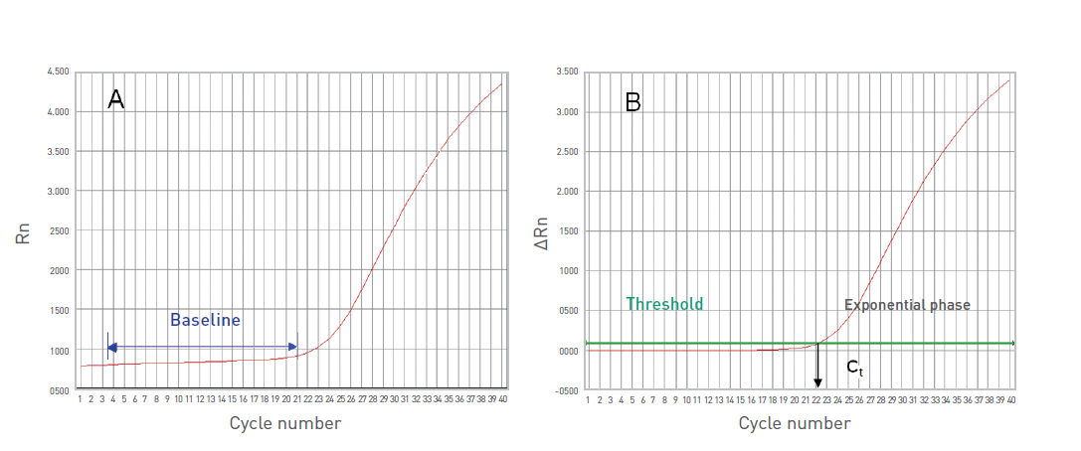

Slide 30
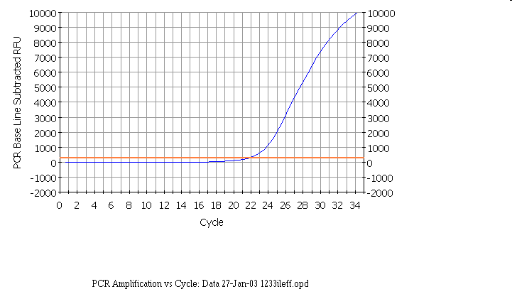
Notes:
In the following discussion the results shown will be those obtained in our laboratory using a BioRad Icycler Real-time PCR instrument. However, analysis with other instruments is similar.
Here is a real-time PCR trace for a single well on a 96-well plate, cycles are shown along the X-axis, and arbitrary fluorescence units (actually these are fold increase over background fluorescence) are shown on the Y-axis - the results are similar to our theoretical graph (see insert) - except that the transition to the plateau phase is more gradual. This expt - and everything we are going to discuss - was done with SYBR green, which has very low fluorescence in the absence of double stranded DNA and very high fluorescence in the presence of double stranded DNA.

Slide 31
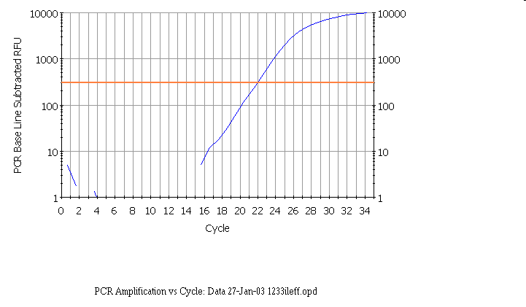
Notes:
Here is the same real time PCR trace shown on a logarithmic scale - again it is similar to our theoretical curve (inset).

Slide 32
Linear ~20 to ~1500
Notes:
As we saw with the theoretical curves, you should get a straight line relationship in the linear part of the PCR reaction. In this case the reaction is linear from ~20 to ~1500 arbitrary fluorescence units.

Slide 33
Linear ~20 to ~1500 Fluorescent Units
Arithmetic scale
PCR baseline subtracted RFU
Same region as log scale
Cycle number
Notes:
If we look at the same region on a regular scale, we see the linear part is the very early part of the curve and note that it is NOT the region which looks linear in this graphical view. This is a very important point in real-time PCR because we wish to examine the reaction while it is still in the linear log phase.

Slide 34
threshold = 300
Notes:
It is important that the threshold should be in the linear part of the reaction - this is easier to see in the logarithmic view, where it should be no more than half way up the linear part, in the regular view, the threshold will be close to the bottom of the curve. However, the threshold should be high enough that you are sure that reactions cross the line due to amplification rather than noise. We find that if the plateau values are 4000 to to 15000, a threshold of 300 usually works well.
We use the same threshold for all the samples in the same experiment on the same plate.

Slide 35
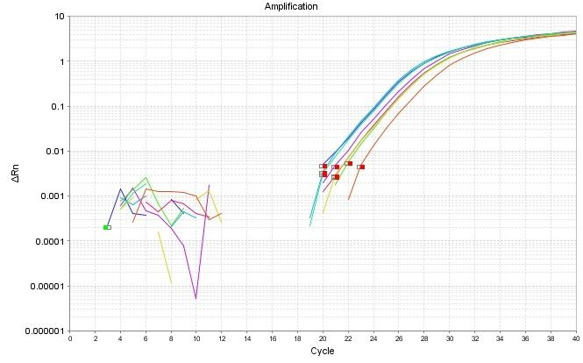
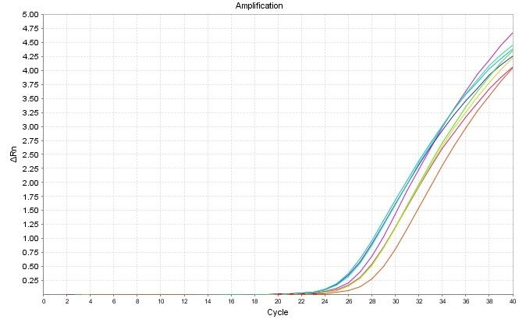
Amplification curve:
log view
Always use during analysis
Plateau
Exponential
Linear
Amplification curve:
linear view

Slide 36
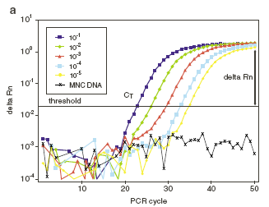
Endpoint analysis
Different concentrations give similar endpoint results!

Slide 38
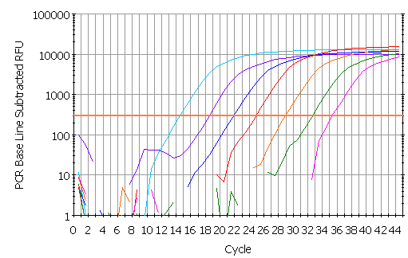
threshold
Ct

Slide 39
Rn: Normalized reporter is the ratio of the fluorescence emission intensity of the reporter dye to the fluorescence emission intensity of the passive reference dye.
ΔRn is the normalization of Rn obtained by subtracting the baseline: (ΔRn = Rn –baseline).
ROX passive reference dye is used to normalize for non-PCR related fluorescence signal variation on certain real-time thermocyclers (ie., Applied Biosystems Prism™ 7000, 7700 and 7900 instruments).

Slide 40
∆Rn
Rn+ is the Rn value of a reaction containing all components (the sample of interest); Rn- is the Rn value detected in NTC (baseline value)
* ∆Rn is the difference between Rn+ and Rn-. It is an indicator of the magnitude of the signal generated by the PCR
* ∆Rn is plotted against cycle numbers to produce the amplification curves and gives the CT value

Slide 41
Real-Time Principles Time Principles
Three general methods for the quantitative assays:
1. Hydrolysis probes
(TaqMan, Beacons, Scorpions)
2. Hybridization probes
(Light Cycler)
3. DNA-binding agents
(SYBR Green)

Slide 42
TaqMan® probes = Double-Dye probes
TaqMan® probes, also called Double-Dye Oligonucleotides, Double-Dye Probes, or Dual Labelled probes, are the most widely used type of probes.
consisted of a single-stranded probe sequence that was complementary to one of the strands of the amplicon.
A fluorophore is attached to the 5’ end of the probe and a quencher to the 3’ end.

Slide 43
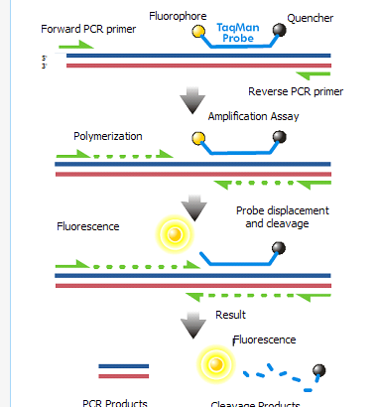
Reporter in qPCR

Slide 44
The fluorophore is excited by the machine and passes its energy, via FRET (Fluorescence Resonance Energy Transfer) to the quencher.
FRET is a through-space mechanism in which energy from the reporter dye is transferred to the quencher without absorption or emission of light.

Slide 45
FAM as the fluorophore (reporter)
TAMRA as the quencher
In a well designed probe FAM does not fluoresce as it passes its energy onto TAMRA.
The probe binds to the amplicon during each annealing step of the PCR.
When the Taq polymerase extends from the primer which is bound to the amplicon, it displaces the 5’ end of the probe, which is then degraded by the 5’-3’ exonuclease activity of the Taq polymerase.
Cleavage continues until the remaining probe melts off the amplicon

Slide 46
Double-Dye probes advantages
• Widely used, several modifications possible
• Specific system
• Multiplex capabilities
No optimization
Double-Dye probes disadvantages
• More expensive than SYBR® Green I, but the lowest cost specific system available

Slide 47
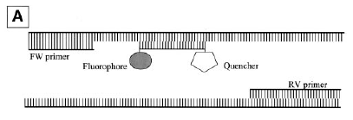
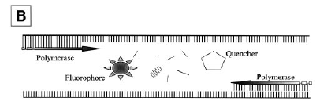
TaqMan probes
Sequence-specific
Doesn´t need much optimization
More expensive

Slide 48
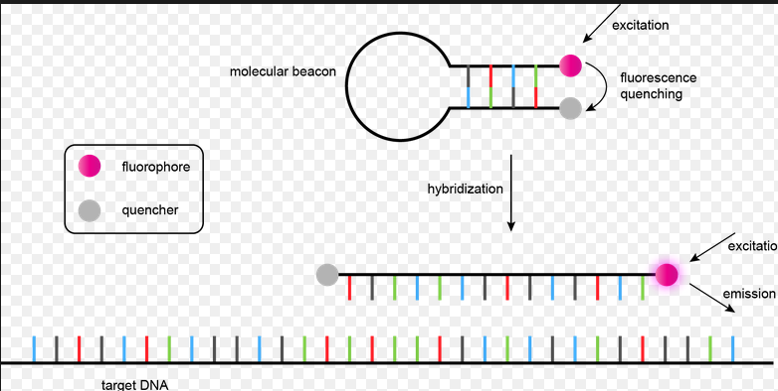
Reporter in qPCR

Slide 49
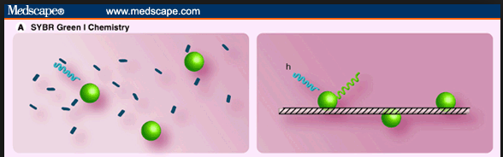
Reporter in qPCR

Slide 50
SYBRgreen
dsDNA intercalating dye
Unspecific (optimization)
cheap
How do We Measure DNA in a PCR Reaction?
3’
5’
5’
3’
5’
3’
5’
3’
Extension
3’
ID
ID
Taq
5’
5’
5’
ID
ID
ID
5’
Taq
3’
Apply Excitation
Wavelength
λ
λ
λ
Taq
3’
ID
ID
ID
5’
5’
Taq
ID
ID
5’
3’
λ
λ

Slide 51
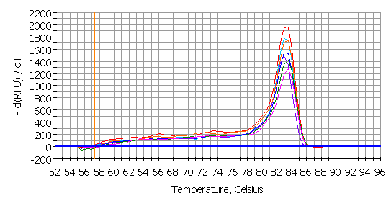
Melting curve – Test the presence of unspecific amplification, contamination, primer dimers,..

Slide 52
High Resolution Melting dyes (HRM dyes)
High Resolution Meltcurve analysis is a newly emerging technology, which characterizes nucleic acid samples based on their dissociation behaviour.

Slide 53
HRM uses the fundamental property of the separation of the two strands of DNA with heat (melting), and the monitoring of this melting with a fluorescent dye.
Melting temperature of a dsDNA target depends on GC content, length, and sequence.

Slide 54
Due to the high sensitivity of HRM dyes, even a single base change will induce differences in the melting curve, and consequently in fluorescence
Main applications of HRM include:
gene scanning (search for the presence of unknown variations in PCR amplicons),
SNP genotyping,
DNA methylation analysis, DNA mapping,
DNA fingerprinting.

Slide 55
This emerging method is less expensive and as precise than probe-based methods.
Roche LightCycler®480, the Corbett Life Science Rotor-Gene™ 6000, and the ABI Prism® 7500.
The main HRM dyes available are EvaGreen, LCGreen®, SYTO® 9 and BEBO.

Slide 56
How do We Measure DNA in a PCR Reaction?
We use reagents that fluoresce in the presence of amplified DNA!
Ex. SYBR Green dye
They bind to double-stranded DNA and emit light when illuminated with a specific wavelength.

Slide 57
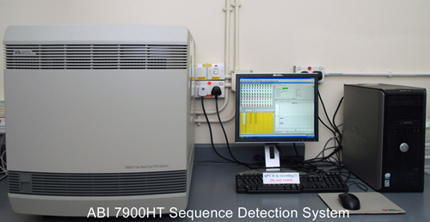
Real-time PCR instruments consist of TWO main components:
Thermal Cycler (PCR machine)
Optical Module (to detect fluorescence in the tubes during the run)
What Type of Instruments are used with Real-Time PCR?

Slide 58
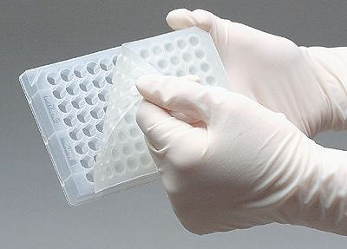
What Type of Instruments are used with Real-Time PCR?
Adequate, optical plates
96/384 wells
Standard/fast
Optical sealing adhesive

Slide 59
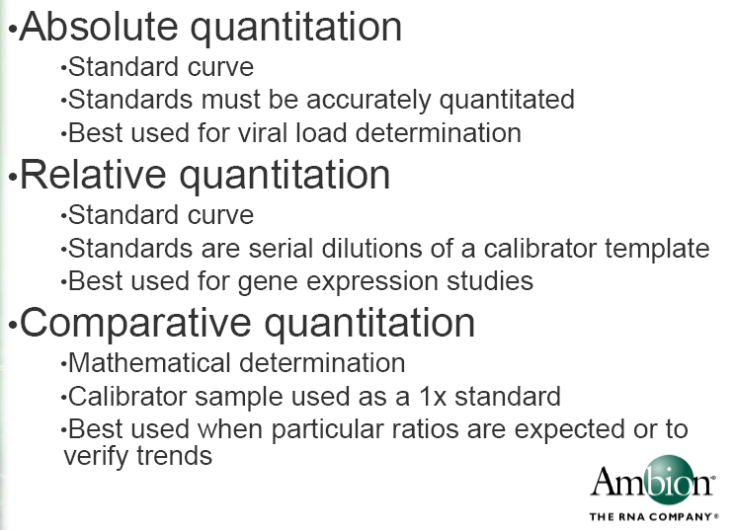

Slide 60
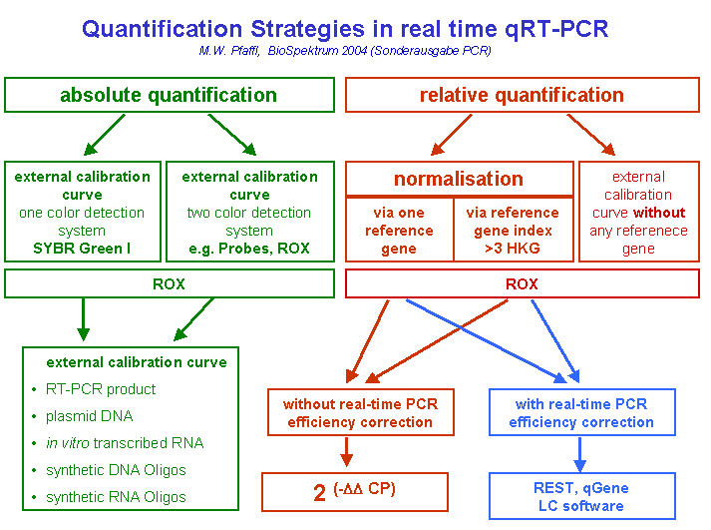

Slide 61
RELATIVE QUANTIFICATION

Slide 62
There’s a DIRECT relationship between the starting amount of DNA, and the cycle number that you’ll reach an arbitrary number of DNA copies (Ct value).
DNA amount = 2 ^ Cycle Number
Imagining Real-Time PCR
Measuring
Quantities

Slide 63
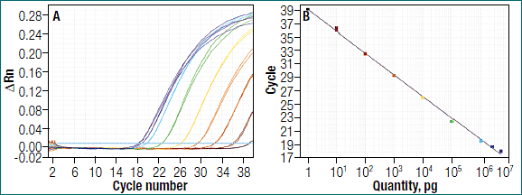
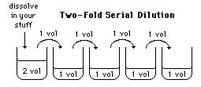
Standard Curve
Quantification and
Normalization
Prepare a 2-fold serial dilution of a DNA sample:
Recomendation: add always a standard curve in every run

Slide 64
Optimized qPCR assay
1. linear standard curve( R2>0.980)
2. high amplification efficiency (90-100%)
3. consistency across replicate reactions

Slide 65
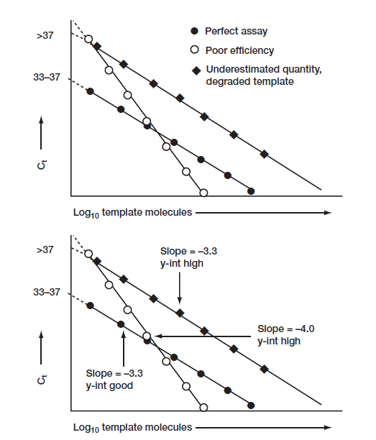
E = 10 [–1/slope]

Slide 66
E = 10^(-1/slope)
E = (10^(-1/slope)-1)*100
Ex. slope = -3,81
efficency= (10^(-1/-3.81)-1)*100 = 83%
Ideal: efficency >95%

Slide 67
COMPERATIVE QUANTIFICATION

Slide 68
First basic underlying principle: every cycle there is a doubling of product.
Second basic principle: we do not need to know exact quantities of DNA, instead we will only deal with relative quantities.
Third basic principle: we have to have not only a “target” gene but also a “normalizer” gene.
Key formula:
  Quantity = 2 ^ ^{(Ct}_{a} ^{– Ct}_{b}⁾
Quantification and
Normalization

Slide 69
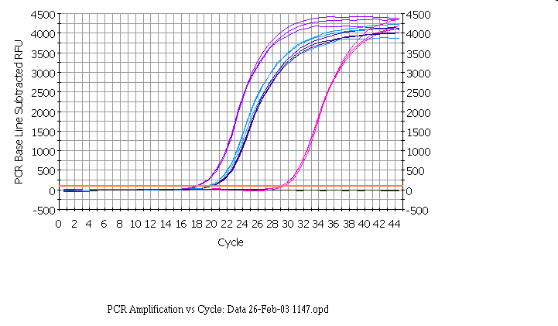
IL1-b vit
RPLP0 con
RPLP0 vit
IL1-b con
Notes:
Here are the results from an experiment in which the target gene was IL1-beta and the reference gene was RPLPO. RNA was extracted from control (con) or vitreous-treated (vit) cells, and copied into cDNA. IL1-b and RPLP0 assays were done in triplicate on both con and vit cDNAs.
We will start by looking at the top part of the “Northern equation” - that is determining the fold change in IL1-b in vitreous compared to control.

Slide 70
IL1-b vit
RPLP0 con
RPLP0 vit
IL1-b con
Notes:
If one looks at the same data that we discussed before. But for the time being ignore the data from the standard ‘loading control’ gene. The difference between the control and treated samples for il1-beta is shown by the red line. If we know the efficiency for il1-beta and the cycle number, we could calculate the fold change in il-1 beta- but there would be no loading control.

Slide 71
Notes:
An approximate correction can be made for the loading control by calculating the difference between the IL1-beta Ct values and the RPLP0 values for the control samples, and then for the vitreous treated samples (represented by the two green lines in the slide). This makes an allowance for the fact that in the above case, there is slightly more mRNA in the vitreous treated samples (since the RPLP0 comes up slightly earlier). This difference (or delta Ct value) is shown by the two green lines above. The difference between the two delta values represents the shift as will be seen in the next slide.

Slide 72
ΔΔCt
EFFICIENCY
METHOD
APPROXIMATION METHOD
Notes:
This method was one of the first methods to be used to calculate these type of results. However, as we shall see, it is an approximation method. It makes various assumptions, and to prove that they are valid is, in our opinion, more time consuming that doing a few extra efficiency runs for the Pfaffl method.

Slide 73
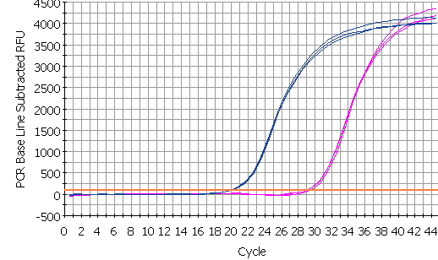
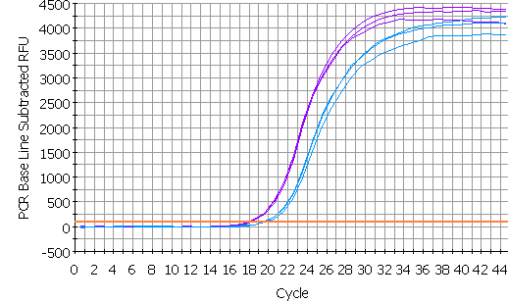
control
Δ Ct = target - ref
RPLP0 con
Δ Ct = 9.70
IL1-b con
av =19.93
av =29.63
experiment
Δ Ct = target - ref
IL1-b vit
Δ Ct = -1.7
RPLP0 vit
Difference = ΔCt(ex)-ΔCt (con)
= ΔΔCt
= 9.70-(-1.7)
= 11.40
av =18.03
av =19.80
Notes:
The difference between the two delta Ct values (delta delta Ct, represents the corrected shift of the IL1-b. Since in this example in the vitreous treated sample the IL1-b has moved to the left of the standard, it has a negative value, but in maths subtraction of a negative value is equivalent to adding that value - which makes obvious sense (I hope) if you look at the diagram - the total shift is = the two green arrows added together. If the vit il1-b had shifted but remained to the right of the reference curve, the value would then be subtracted from the large green arrow to determine the shift.

Slide 74
ΔΔCt = 11.40 for IL1-beta
2 ^{ΔΔCt} variant: assumes efficiency is 100% Fold change = 2^{11.40} = 2702
But our efficiency for IL1-beta is 93%
  Fold change = 1.93^{11.40} = 1800
Pfaffl equation corrected for RPLP0 efficiency
  Fold change = 1901
Notes:
Note how different the results are when the correct efficiency is used rather than assuming 100%. The results are much closer to the ones calculated with the accurate method. However, note that the efficency of the RPLP0 was never taken into account with this approximation method. This method assumes that the efficiency of RPLP0 is so close to that of IL1-beta that it does not make much difference - or that the reference gene values are so similar for different RNA samples that the correction is so small that it would not be significant (it was only 1.08 fold when we calculated the change in RPLP0 cDNA for these same samples when discussing the Pfaffl method).

Slide 75
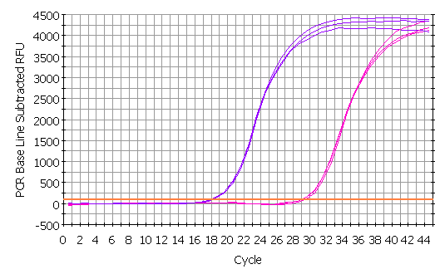
IL1-beta
IL1-b vit
IL1-b con
av =18.03
av =29.63
AFTER N CYCLES: change = (efficiency)^{n}
AFTER N CYCLES: ratio vit/con = (1.93)^{29.63-18.03} =1.93^{11.60} = 2053
Notes:
So here we are just looking at the results from the wells containing the IL1-b primers. If we look at the difference in Ct values between the control and vitreous samples we see there is an 11.60 cycle difference. Earlier on we derived the equation that the change in amount of DNA after n cycles is equal to the efficiency to the power of n. We independently do multiple serial dilution curves on multiple days to determine an average efficiency and we can then plug that value into the formula. Note that when determining the difference in the Ct values (sometimes known as the ‘delta Ct’), we subtract the vitreous from the control value - this is so that increases will have a positive result and decreases a negative result for the delta Ct value.
If the amount of RNA is less in the vitreous sample the delta Ct would have a negative value and the change would have a value of less than 1.00. So, if there was half as much target mRNA the value for the change would be 0.5.
These calculations are easily done if you have an excel spreadsheet set up (see later slide).

Slide 76
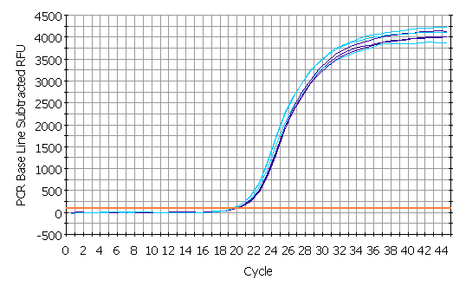
RPLP0
RPLP0 con
RPLP0 vit
av =19.80
av =19.93
AFTER N CYCLES: change = (efficiency)^{n}
AFTER N CYCLES: ratio vit/con = (1.87)^{19.93-19.80} =1.87^{0.13} = 1.08
Notes:
Here we are just looking at the RPLP0 data - note, that, as expected for a good reference gene, there is not much difference between the two RNAs with regard to their levels of RPLP0 mRNA. The same amount of total RNA was used for reverse transcription of both RNAs, and the same amount of each reverse transcription reaction was used for real-time PCR. Since the Ct values are so close and the ratio of the reference gene in the two samples is close to one, this suggests that this is a good reference gene for these experiments.
Of course this method requires that you have determined the efficiency for your primers. We do this on multiple occasions, using the criteria for a good curve discussed above. We find that the values tend to be very reproducible if we use stabilized sybr green mixes. If we change manufacturer or if the formulation is changed, the efficiency will need to be determined again.

Slide 77
“normalizer” gene
Quantification and
Normalization
Knowing the amount of mRNA in one sample from one specific gene does not tell us much..
You need to know the total amount of mRNA in your sample
You also dont know how much the mRNA level has changed compared to other mRNA levels
Example:
mRNA levels of a gene increase 2x after induction
It is possable that all (1) genexpression in the cell has increased (2) the induced samples contained more total mRNA
→We have to compare the expression of our gene to another gene which expression is normally constant, a housekeeping gene (ex. TBP, 18S)

Slide 78
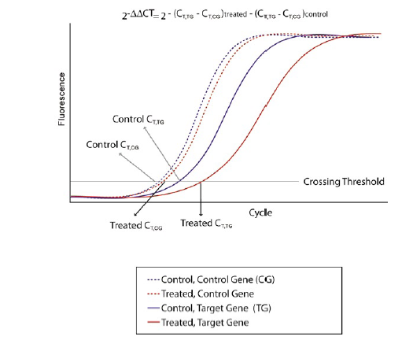
ΔΔCt method
experiment
control
-[(Ct_{tg}-Ct_{cg})-(Ct_{tg}-Ct_{cg})]
2
Ex!
Ct = target gene– ref gene
Δ Ct = 9.70
Ct = target gene– ref gene
Δ Ct = -1.70
Difference = ΔCt-ΔCt
= ΔΔCt
= 9.70-(-1.7)
= 11.40
Fold change = 2^{11.40} = 2702
Always in duplicate or triplicate!

Slide 79
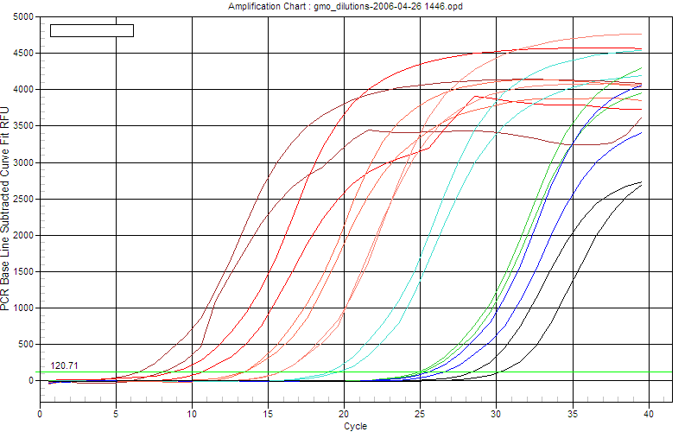
Quantification
and
Normalization

Slide 80
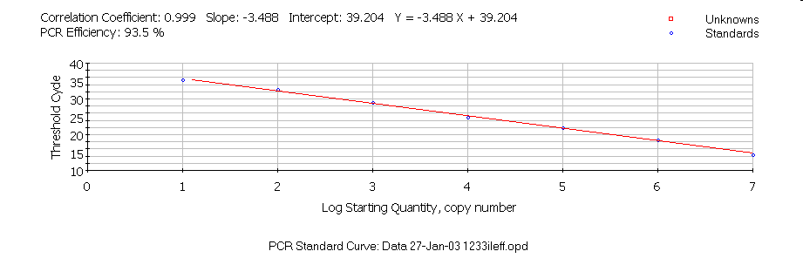

Slide 81
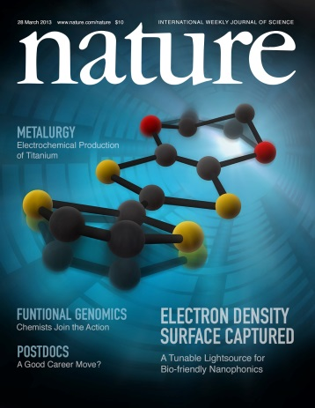
Results?
Good experimental design
Optimal primers
Good RNA
Good cDNA
Adequate nr of samples
Adequate nr of replicates
Good STATISTICS
Gene | Value | Call
A | 1.828745739 | up regulated
B | 2.04179718 | up regulated
C | 0.666738198 | unaffected
D | 1.999855536 | up regulated
E | - 0.450673805 | unaffected
F | 0.509327854 | unaffected
G | - 1.195371388 | down regulated
UCE | 0 | control gene

Slide 82
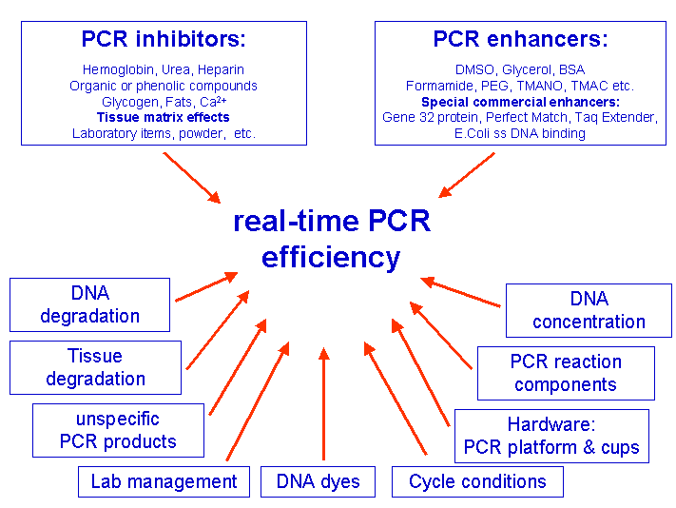

Slide 83
Primers
• Length : 18-30 bases
• GC content : 30-80 % (ideally 40-60 %)
• Tm : 55-60 °C, ∆Tm difference between forward primer and reverse primer should
be ≤ 4 °C
• Avoid mismatches between primers and target, especially towards the 3’ end of the primer. Avoid runs of identical nucleotides, especially of 3 or more Gs or Cs at the 3’ end.
• Avoid 3’ end T (allows mismatching)
• Avoid complementarities within the primers to avoid hairpins
• Avoid complementarities between the primers to avoid primer dimers, especially
of 2 or more bases at the 3’ ends of the primers
• Check if primers are unique and specific (check with a BLAST search: NCBI BLAST
• Design intron spanning or intron flanking primers to prevent amplification of contaminating genomic DNA.

Slide 84
1. primer design (Tm)
2. primer concentration (100 and 900 nM may be up to 1 µM)
3. Choosing the primer annealing temperature ( 5 to 10 degree higher than Tm of primers)
4. concentration and purity of the samples ( ratio: A260/A280 1.8 to 2).
Template amount: (human genomic DNA: 500ng, CDNA: 10% of total reaction or 100ng)

Slide 85
Reaction component
Master mix 2X
Forward primer
Reverse primer
CDNA
Template
D.W

Slide 90
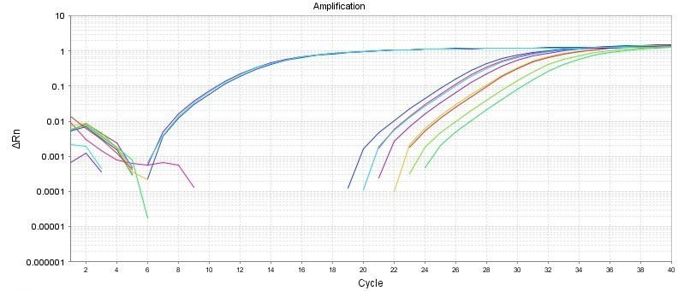
Good Comparative Ct example
(for gene expression)
Endogenous control
Gene of interest
Small variation in endogenous control Ct values
Shape of curve, including linear phase (log view)

Slide 91
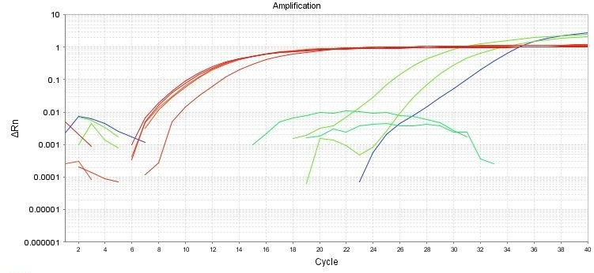
1
Bad Comparative Ct example
1
2
2
3
Too much variation in endogenous control Ct values
Sigmoidal curves. Check baseline levels
No amplification

Slide 92
Endogenous control gene:
Present in all experimental samples
Expression does not vary between treatments, tissues, age, etc. i.e. constant expression levels
By using an endogenous control as an active reference you can normalize quantification of mRNA target for differences in the amount of total RNA added to each sample. i.e. loading control
Commonly used: 18S or 25S rRNA, actin, GAPDH, ubiquitin, etc

Slide 93
Reference sample
Used in Comparative C_{T} and relative standard curve experiments
Sample used as the basis for relative quantitation results. i.e. Everything gets expressed and compared relative to this sample.
Also called calibrator
It doesn’t matter which sample is used, however normally the negative control is used.

Slide 94
Amplification curve:
log view
Always use during analysis
Plateau
Exponential
Linear
Amplification curve:
linear view

Slide 95
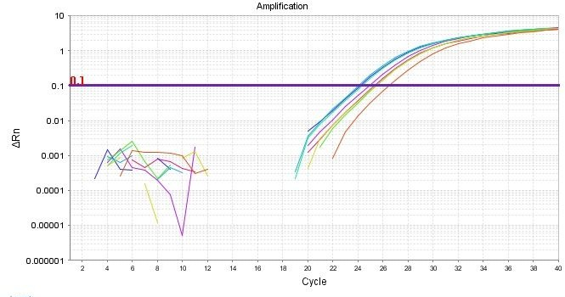
It's all about Ct
Threshold
Ct

Slide 96
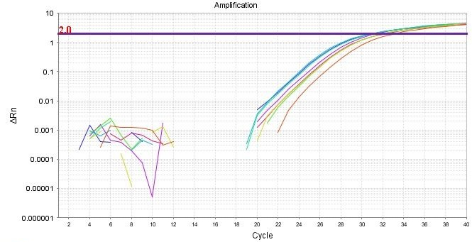

Threshold set too high
Threshold set too low

Slide 97
Threshold is important
Threshold determines Ct values
Ct values are used to calculate relative expression, presence/absence, etc. It's all about Ct values
Threshold should be set in the linear portion (parallel lines) in log view. Always check!
Do not use Ct values of 35 or higher. Repeat using more cDNA/DNA

Slide 98
Good Comparative Ct example
(for gene expression)
Endogenous control
Gene of interest
Small variation in endogenous control Ct values
Shape of curve, including linear phase (log view)

Slide 99
1
Bad Comparative Ct example
1
2
2
3
Too much variation in endogenous control Ct values
Sigmoidal curves. Check baseline levels
No amplification

